Slide 1
Statistical Analysis of
Non Banking Mobile App Users
B.K.S.Ishanka 209334C

Slide 2
Questionnaire
73 responses
12 Questions
Languages -Sinhala & English
Question types
Demographic questions - 5
Questions related to mobile banking application usage - 7

Slide 3
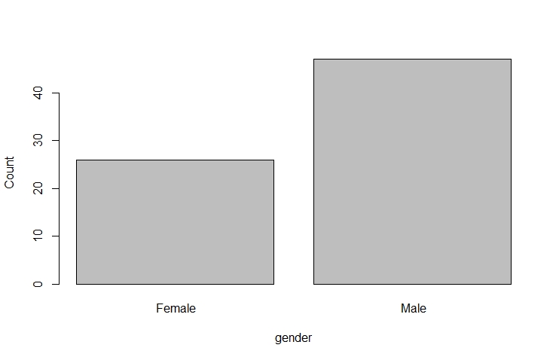
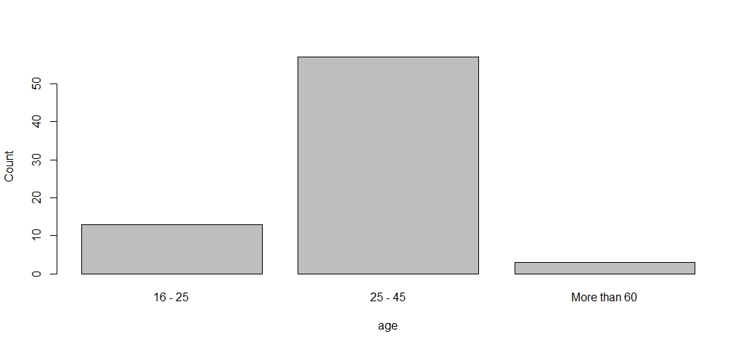
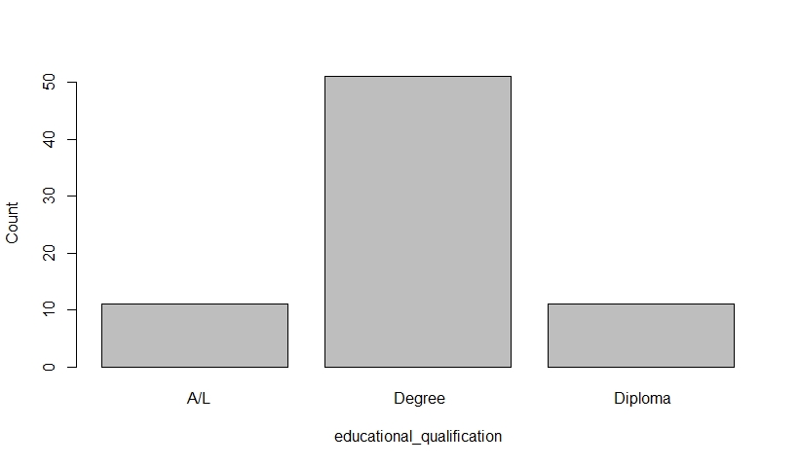
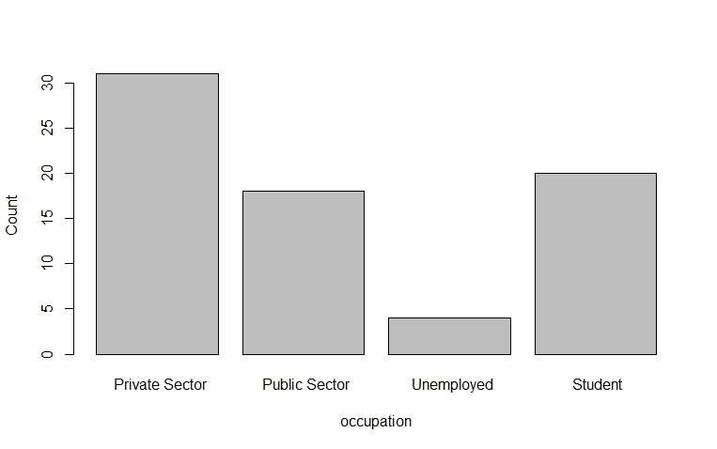
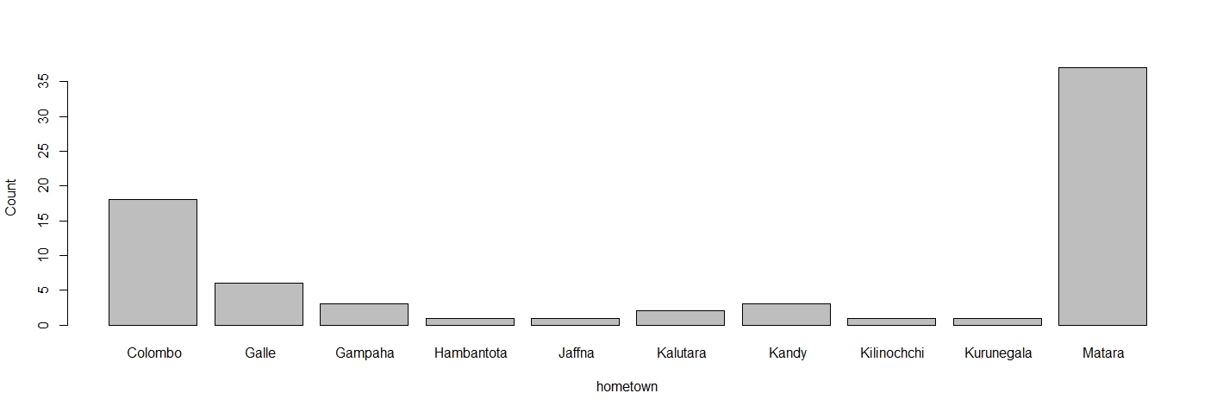
Questionnaire - Demographic Questions
Notes:
Employees in Amazon

Slide 4
Questionnaire - Mobile banking application usage
 | Yes | No | No idea
Have you heard of banking mobile apps before? | 72 | 1 | -
If yes to above question, do/does your bank/banks provide the facility? | 71 | 1 | 1
Have you earlier used banking mobile apps before? | 39 | 34 | -
Do you think, Banking Mobile Apps would help you to make your bank processes comfortable? | 67 | 5 | 1
Do you own a smart phone? | 70 | 3 | -
Do you think you could install a mobile banking app and use it for your banking processes? | 67 | 3 | 3
Other than the above points, what is/are the reason/reasons for not using mobile banking apps? | - | - | -

Slide 5
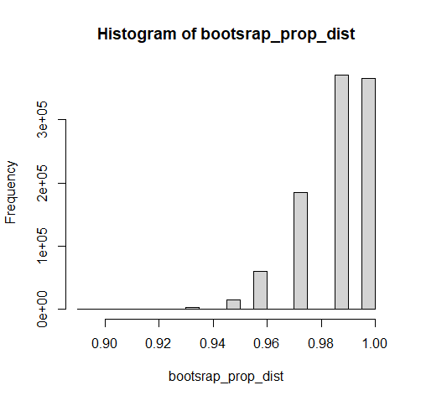
Analysis - Distribution of a Sample Proportion
Most of the people have heard of mobile banking applications
p = Proportion of people who have heard of mobile banking applications.
H₀ : p = 72/73 = 0.986
H_{a} : p ≠ 1/73 = 0.014
No decision can be derived
Yes | No
72 | 1
0.986 | 0.986
Most of the people have heard of mobile banking applications
p = Proportion of people have earlier used banking mobile apps.
H₀ : p = 0.5
H_{a} : p < 0.5
Conditions of Test for a Single Proportion : n*p = 39 > 10 , n*(1-p) = 34 > 10
p-value = 0.28
Null hypothesis cannot be rejected
Yes | No
39 | 34
0.53 | 0.47

Slide 6
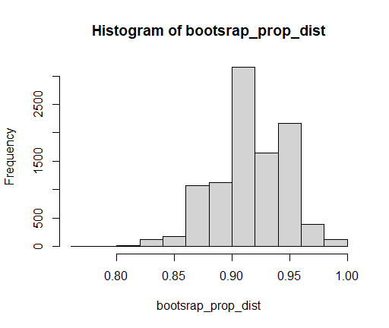
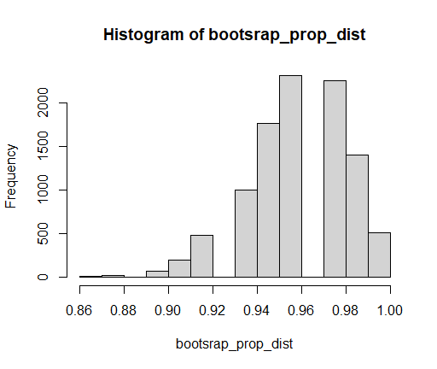
Analysis - Distribution of a Sample Proportion
Most of the people think Mobile Apps would help you to make your bank processes comfortable
p = Proportion of people who think Mobile Apps
would help you to make your bank processes comfortable
H₀ : p = 67/73 = 0.9178
H_{a} : p ≠ 6/73 = 0.0822
95% confidence interval : (0.9171,0.9181)
Null hypothesis can not be rejected
Yes | No
67 | 6
0.9178 | 0.0822
Most of the people use smart phone
p = Proportion of people who use smart phone
H₀ : p = 70/73 = 0.96
H_{a} : p ≠ 3/73 = 0.04
No decision can be derived
Yes | No
70 | 3
0.96 | 0.04

Slide 7
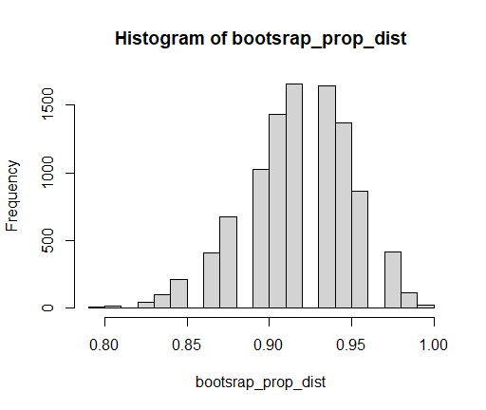
Analysis - Distribution of a Sample Proportion
Most of the people could install a mobile banking app and use it for your banking processes
p = Proportion of people who could install a mobile banking app and use it for your banking processes
H₀ : p = 67/73 = 0.9178
H_{a} : p ≠ 6/73 = 0.0822
95% confidence interval : (0.9173,0.9184)
Null hypothesis can not be rejected
Yes | No
67 | 6
0.9178 | 0.0822

Slide 8
Analysis - Distribution of Differences in Proportions
Most of the males have heard of mobile banking applications.
p1 = Proportion of males who have heard of mobile banking applications
p2 = Proportion of males who have heard of mobile banking applications
H₀ : p1 = p2
H_{a} : p1 > p2
Conditions of Test for a Difference Proportion : n₁*p₁ = 31 > 10, n₁*(1-p₁) = 8 < 10, n₂*p₂ = 16 > 10, n₂*(1-p₂) = 18 > 10
Hypothesis test can not be completed
 | Male | Female | Total
Yes | 31 | 8 | 39
No | 16 | 18 | 34
Total | 47 | 26 | 73
Majority of private sector employees have earlier used banking mobile apps.
p1 = Proportion of private sector employees who have earlier used banking mobile apps
p2 = Proportion of rest of the employees who have earlier used banking mobile apps
H₀ : p1 = p2
H_{a} : p1 > p2
Conditions of Test for a Difference Proportion : n₁*p₁ = 22 > 10, n₁*(1-p₁) = 17 > 10, n₂*p₂ = 25 > 10, n₂*(1-p₂) = 9 < 10
Hypothesis test can not be completed
 | Private sector | Rest | Total
Yes | 22 | 17 | 39
No | 25 | 9 | 34
Total | 47 | 26 | 73

Slide 9
Analysis - Association tests
Association between earlier usage of banking mobile apps and gender.
H₀: Gender is not associated with earlier usage of banking mobile apps
H_{a}: Gender is associated with earlier usage of banking mobile apps
χ² = 8.33
p-value = 0.004 => Reject H₀
 | Male | Female | Total
Yes | 31(25.11) | 8(13.89) | 39
No | 16(21.89) | 18(12.11) | 34
Total | 47 | 26 | 73
Association between earlier usage of banking mobile apps and education level.
H₀: Education level is not associated with earlier usage of banking mobile apps
H_{a}: Education level is associated with earlier usage of banking mobile apps
χ² = 12.10828
p-value = 0.0023 => Reject H₀
 | Degree | Diploma | A/L | Total
Yes | 34(27.25) | 3(5.88) | 2(5.88) | 39
No | 17(23.75) | 8(5.12) | 9(5.12) | 34
Total | 51 | 11 | 11 | 73

Slide 10
Conclusions
Hypothesis tests conclusions
Most of the people have heard of mobile banking applications
Most of the people think Mobile Apps would help you to make your bank processes comfortable
Most of the people could install a mobile banking app and use it for your banking processes
Association between earlier usage of banking mobile apps and gender
Association between earlier usage of banking mobile apps and education level
Notes:
Employees in Amazon

Slide 11
Thank You

